Slide 1
Recovery

Slide 2
Recoverable
Transactions may be aborted due to logical failure. e.g. deadlock
Recoverability is required to ensure that aborting a transaction does not change the semantics of committed transaction's operations.
Example
Write1(x,2); Read2(x); Write2(y,3); Commit2
Not recoverable.
T2 has committed before T1 commits.
The problem is: what can we do if T1 abort?
Delaying the commitment of T2 can avoid this problem
A schedule H is called recoverable (RC) if, whenever Ti reads from Tj. (i≠ j) in H and ci ϵ H, cj < ci.
Intuitively, a history is recoverable if each transaction commits after the commitment of all transactions (other than itself) from which it reads.

Slide 3
Avoiding Cascading Aborts
Even for recoverable execution, aborting a transaction may trigger further abortions, a phenomenon called cascading abort.
Example
Write1(x,2); Read2(x); Write2(y,3); Abort1
T2 must abort because if it ever committed, the execution would no longer valid.
A schedule H avoids cascading aborts (ACA) if, whenever Ti reads x from Tj (i ≠ j), cj < ri[x].
That is, a transaction may read only those values that are written by committed transactions or by itself.

Slide 4
Strict Executions
Avoiding cascading aborts is not always enough from the practical point of view.
Write1(x,1); Write1(y,3); Write2(y,1); Commit1; read2(x); Aborts2$
If we erase the operations from T2, the resulting execution should be
Write1(x,1); Write1(y,3); Commit1
The value of y should be 3.
The value should be restored for y when T2 is aborted.
Implement abort by restoring the before images of all Writes of a transaction.
The before image of a Write(x,val) operation in an execution is the value of x just before this write operation.

Slide 5
The following example illustrates the problem
Write1(x,2); Write2(x,3); Abort1
Assume the initial value of x is 1.
i.e., the before image of Write1(x,2) is 1.
Blindly restoring the before image will lead to a wrong result.
Another example (assume the initial value of x is 1)
Write1(x,2); Write2(x,3); Abort1; Abort2
The before image of Write2(x,3) is 2.
After Write2(x,3) has been undone, the value of x should be 1.
We can avoid these problems by requiring that the execution of a Write(x,val) be delayed until all transactions that have previously written x are either committed or aborted.
A schedule H is strict (ST) if whenever wj[x] < oi[x] (i ≠ j), either aj < oi[x] or cj < oi[x] where oi[x] is ri[x] or wi[x].
This property can be enforced by using the strict two-phase locking protocol (locks are released at the end of transactions), i.e., Strict 2PL guarantees both conflict serializability and strict execution.

Slide 6
Examples
T1 = w1[x] w1[y] w1[z] c1
T2 = r2[u] w2[x] r2[y] w2[y] c2
H1 = w1[x] w1[y] r2[u] w2[x] r2[y] w2[y] c2 w1[z] c1
H2 = w1[x] w1[y] r2[u] w2[x] r2[y] w2[y] w1[z] c1 c2
H3 = w1[x] w1[y] r2[u] w2[x] w1[z] c1 r2[y] w2[y] c2
H4 = w1[x] w1[y] r2[u] w1[z] c1 w2[x] r2[y] w2[y] c2
H1 is not RC, because T2 reads y from T1, but c2 < c1.
H2 is RC but not ACA, because T2 has read y from T1 before T1 commits.
H3 is ACA but not ST, because T2 has overwritten the value written into x by T1 before T1 terminates
H4 is strict.

Slide 8
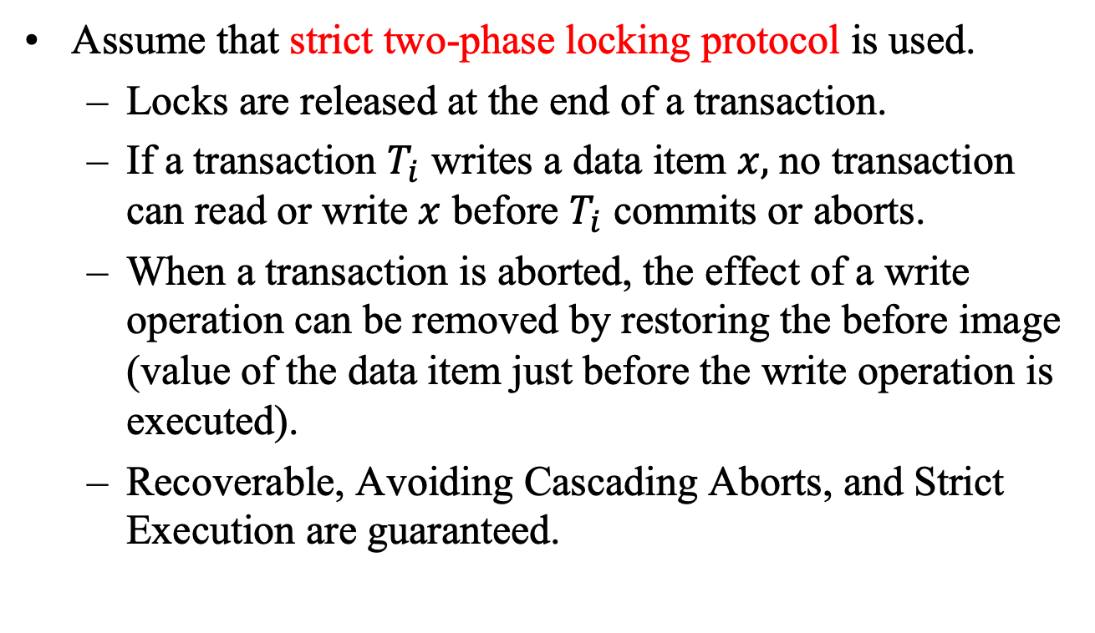
Transaction Execution
Assume that strict two-phase locking protocol is used.
Locks are released at the end of a transaction.
If a transaction $T_{i}$ writes a data item $x,$ no transaction can read or write $x$ before $T_{i}$ commits or aborts.
When a transaction is aborted, the effect of a write operation can be removed by restoring the before image (value of the data item just before the write operation is executed).
Recoverable, Avoiding Cascading Aborts, and Strict Execution are guaranteed.

Slide 9
Crash Recovery
Storage Types
Volatile storage: Does not survive system crashes. e.g. main memory, cache memory.
Nonvolatile storage: Survives system crashes. e.g. disk, tapes.
Stable storage: never lost. e.g. implemented by replication.
Failure Types
Logical errors: cannot continue execution because of internal conditions. e.g. bad input, data not found, overflow, resource limit exceeded.
System errors: the system has entered an undesirable state. e.g. deadlock.
System crash: hardware malfunctions, causing the loss of the content of volatile storage. e.g. power failure.
Disk failure: disk block loses its content. e.g. head crash, failure during a data transfer operation.

Slide 10
Storage Hierarchy
The database system resides in nonvolatile storage (disk).
Data transfer are in terms of block (page).
Physical block: block residing on the disk.
Buffer block: blocks residing temporarily in main memory.
Block movements between disk and main memory are initiated through:
input(X): From disk to memory
output(X): From memory to disk.

Slide 12
Transactions interact with the database:
Data in database ↔ program variables.
read(X,xi): assigns the value of data item X to the local variable xi.
Issue input(X), if X is not in the buffer.
Assign the value of X to xi.
write(X,xi): assigns the value of local variable xi to data item X.
Issue input(X), if X is not in the buffer.
Assign the value of xi to X in the buffer block for X.
Not specifically require the transfer of a block from buffer to disk.
A buffer block is eventually written out to the disk either:
Buffer manager needs the memory space.
Force-output

Slide 13
Examples
The consistency constraint is that the sum of A and B is unchanged.
Initial values of A and B are $1000 and $2000
Main memory contains the buffer block A.
read(A,a1)
a1 := a1 - 50
write(A,a1)
read(B,b1)
b1 := b1 + 50
write(B,b1)

Slide 15
read(A,a1)
a1 := a1 - 50
write(A,a1)
read(B,b1)
b1 := b1 + 50
write(B,b1)
read(A,a1): a1 ← A.
write(A,a1)
read(B,b1): input(B); b1 ← B

Slide 16
read(A,a1)
a1 := a1 - 50
write(A,a1)
read(B,b1)
b1 := b1 + 50
write(B,b1)
Write(B,b1)
What is the state of the database after output(A), but before output(B)?
What if the system crashes at this moment?

Slide 17
Log-Based Recovery
Recording database modifications in the log.
Each record describes a single database write, and has the following fields:
Transaction name.
Data item name.
Old value (optional)
New value
Special log record:
<Ti, start>
<Ti, commit>
<Ti, abort>

Slide 18
Require undo: If it allows an uncommitted transaction to record in the stable database values it wrote.
Require redo: If it allows a transaction to commit before all the values it wrote have been recorded in the stable database.
Undo Rule: If x's location in the stable database presently contains the last committed value of x , then that value must be saved in stable storage (log) before being overwritten in the stable database by an uncommitted value.
Redo Rule: Before a transaction can commit, the value it wrote for each data item must be in stable storage (log).

Slide 19
Immediate Database Modification (undo/redo)
Allow database modifications to be output to the database while the transaction is active.
T0:
Read(A,a1)
a1 := a1 – 50
Write(A,a1)
Read(B,b1)
b1 := b1 + 50
Write(B,b1)
T1:
Read(C,c1)
c1 := c1 – 100
Write(C,c1)
Log:
<T0,starts>
<T0,A,1000,950>
<T0,B,2000,2050>
<T0,commits>
<T1,starts>
<T1,C,700,600>
<T1,commits>
Note: When T0 and T1 are executed concurrently, their log records may be interleaved.

Slide 20
Transaction Ti needs to be undone if the log contains <Ti,starts> but does not contain <Ti,commits>.
Transaction Ti needs to be redone if the log contains both <Ti, starts> and <Ti,commits>.
Log | Database
<T0,starts>
<T0,A,1000,950>
 | A = 950
<T0,B,2000,2050>
 | B = 2050
<T0,commits>
<T1,starts>
<T1,C,700,600>
 | C = 600
<T1,commits>
The write operations only update
the data items in the buffer.
The updated values may not have been
flushed to the hard disk.

Slide 21
<T0,starts>
<T0,A,1000,950>
<T0,B,2000,2050>
<T0,starts>
<T0,A,1000,950>
<T0,B,2000,2050>
<T0,commits>
<T1,starts>
<T1,C,700,600>
<T0,starts>
<T0,A,1000,950>
<T0,B,2000,2050>
<T0,commits>
<T1,starts>
<T1,C,700,600>
<T1,commits>
Undo T0
Redo T0, undo T1
Redo T0, redo T1
Note: Under concurrent execution, the log records from different transactions may interleave.

Slide 22
Detailed Procedure
Ti: Start
Write <Ti,start> to log
Ti: Write(x,v)
If x is not in the buffer, fetch it.
Append <Ti,x,ov,v> to the log.
Write v into the buffer slot occupied by x.
Acknowledge the scheduler.
Ti: Read(x)
If x is not in the buffer, fetch it.
Return the value in x’s buffer slot to the scheduler.

Slide 23
Ti: Commit
Write <Ti, commit>
Acknowledge the scheduler.
Ti: abort
For each data item x updated by Ti
If x is not in the buffer, allocate a slot for it.
Copy the before image (ov) of x wrt Ti into x’s buffer slot.
Write <Ti, abort>
Acknowledge the scheduler.

Slide 24
Restart
Discard all buffer slots.
Let redone = {} and undone = {}.
Scan the log backward. Repeat the following steps until either redone ∪ undone equals the set of all data items, or there are no more log entries. For each log entry <Ti,x,ov,v>, if x ∉ redone ∪ undone, then
if x is not in the buffer, allocate a slot for it.
if the commit record of Ti has been found, copy v into x's buffer slot and set redone := redone ∪ {x}.
otherwise, copy the before image (ov) of x wrt Ti into x's buffer slot and set undone := undone ∪ {x}.
Acknowledge the completion of Restart to the scheduler.

Slide 25
Example
<T0,starts>
<T0,A,1000,950>
<T1, starts>
<T1,C,700,600>
<T0,B,2000,2050>
<T0,commits>
<T1,A,950,1500>
Suppose after a crash the values of A, B and C
found in the stable database are 1500, 2000 and 600
respectively.
Here is the log found in the stable storage.
From the log, we know that T0 has committed before
the crash.
 | Action (redo/undo) | A | B | C
 |  | 1500 | 2000 | 600
<T1,A,950,1500> | undo | 950 | 2000 | 600
<T0,B,2000,2050> | redo | 950 | 2050 | 600
<T1,C,700,600> | undo | 950 | 2050 | 700
<T0,A,1000,950> | no action | 950 | 2050 | 700

Slide 26
Deferred Database Modification (No-undo/redo)
Recording all database modifications in the log, but deferring the execution of all write operations until the transaction commits.
Log | Database
<T0,starts>
<T0,A,950>
<T0,B,2050>
<T0,commits>
 | A = 950
 | B = 2050
<T1,starts>
<T1,C,600>
<T1,commits>
 | C = 600
Before a transaction commits, the
update will not be written to the database
(not even in the buffer).
After a transaction has committed, the
data items in the buffer are updated.
The updated values may not have been
flushed to the hard disk.

Slide 27
<T0,starts>
<T0,A,950>
<T0,B,2050>
<T0,starts>
<T0,A,950>
<T0,B,2050>
<T0,commits>
<T1,starts>
<T1,C,600>
<T0,starts>
<T0,A,950>
<T0,B,2050>
<T0,commits>
<T1,starts>
<T1,C,600>
<T1,commits>
No action is needed
Redo T0
Redo T0, redo T1
Note: Under concurrent execution, the log records from different transactions may interleave.

Slide 28
Detailed Procedure
Ti: Start
Write <Ti,start> to log
Ti: Write(x,v)
Append <Ti,x,v> to the log.
Acknowledge the scheduler.
Ti: Read(x)
If Ti has previously written into x, then return the after image of x wrt Ti.
Otherwise
If x is not in the buffer, fetch it.
Return the value in x’s buffer slot to the scheduler.

Slide 29
Ti: Commit
Write <Ti, commit> to the log
For each x update by Ti
If x is not in the buffer, fetch it.
Copy the after image (v) of x wrt Ti into x’s buffer slot.
Acknowledge schedule
Ti: abort
Write <Ti, abort>
Acknowledge the scheduler.

Slide 30
Restart
Discard all buffer slots.
Let redone = {}.
Scan the log backward. Repeat the following steps until either redone equals the set of all data items, or there are no more log entries. For each log entry <Ti,x,v>, if the commit record of Ti has been found and x ∉ redone, then
allocate a slot for x in the buffer;
Copy v into x’s buffer slot;
redone := redone ∪ {x}.
Acknowledge the scheduler.

Slide 31
Example
<T0,starts>
<T0,A,950>
<T1, starts>
<T1,C,600>
<T0,B,2050>
<T0,commits>
<T1,A,1500>
Suppose after a crash the values of A, B and C
found in the stable database are 950, 2000 and 700
respectively.
Here is the log found in the stable storage.
From the log, we know that T0 has committed before
the crash.
 | Action (redo) | A | B | C
 |  | 950 | 2000 | 700
<T1,A,1500> | No action | 950 | 2000 | 700
<T0,B,2050> | redo | 950 | 2050 | 700
<T1,C,600> | No action | 950 | 2050 | 700
<T0,A,950> | redo | 950 | 2050 | 700

